Slide 1

Market Basket Web App CSC 520
Marouane Benchater
CSC 521 AdvIsor: Bo Hatfield

Slide 2
Contents
Student Objectives
Problem Specification
Requirement Collection and Analysis
Use Case Diagram
3 Tier Top Level Architecture Diagram
UI Mock-Ups
Preliminary Database ER-Diagram
Benchmark Specification
Time Schedule
Grading Scheme for CSC 521
Tool Lis
Deliverables

Slide 3
Student Objectives
Practice software development through the life cycle of a complete system
Design and implement a UI front-end for the end users
Enhance my skills on relational database design and implementation
Enhance the server-side programming skills.

Slide 4
Problem Specification
WebApp allows Shoppers to search, view information search and put what they want in the shopping cart
The WebApp allows managers to easily manage everything in the store
Notes:
Talk about Motivation During quarantine, a lot people could not go out and shop as they were afraid to get sick. That’s when I came up with the idea of a Web App where people can order and get their grocery delivered to their doors without having to wait in line to get into stores or risking getting sick.
(covid, aisle searching)

Slide 5
Requirement Collection and Analysis
Stakeholders:
Shoppers
Admin (store manager)
Notes:
State: stakeholders are Shoppers and Store managers

Slide 6
Requirement Collection and Analysis
Functionalities for the shoppers:
Login and browse (Group 1 Functionality)
Search for items (Group 1 Functionality)
View deals of the week (Group 1 Functionality)
Check for supermarket hours (Group 1 Functionality)
Managing Shopping cart (Group 2 Functionality)
Functionalities for the admin:
Login
Add new store items
Delete existing store items
Update store prices
Manage aisle information
Update deals of the week
Notes:
Talk about this a lot: Here we have functionalities for both shoppers and admins. I divided shoppers functionalities into two groups. First group consists of: login and browse ….
While the functionalities for the admin are : login, add new store items….

Slide 7
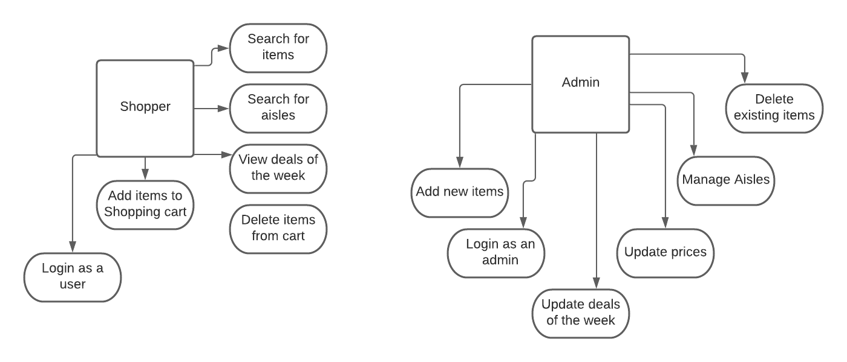
Use Case Diagram
Notes:
Don’t talk about this a lot

Slide 8
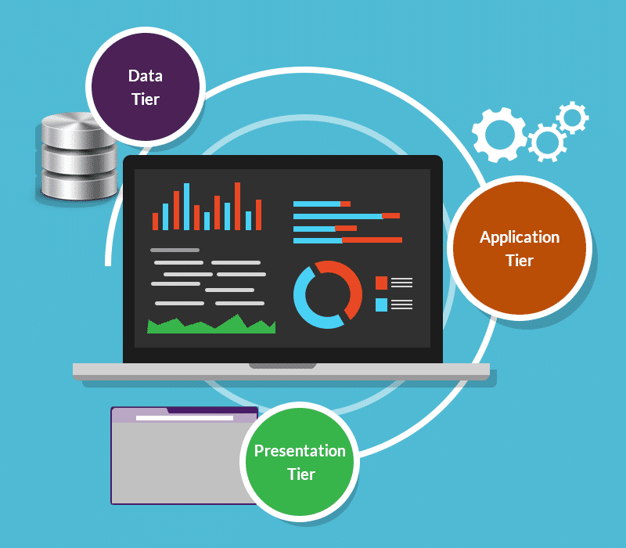
3 Tier Top Level Architecture Diagram
Notes:
Don’t talk a lot

Slide 9
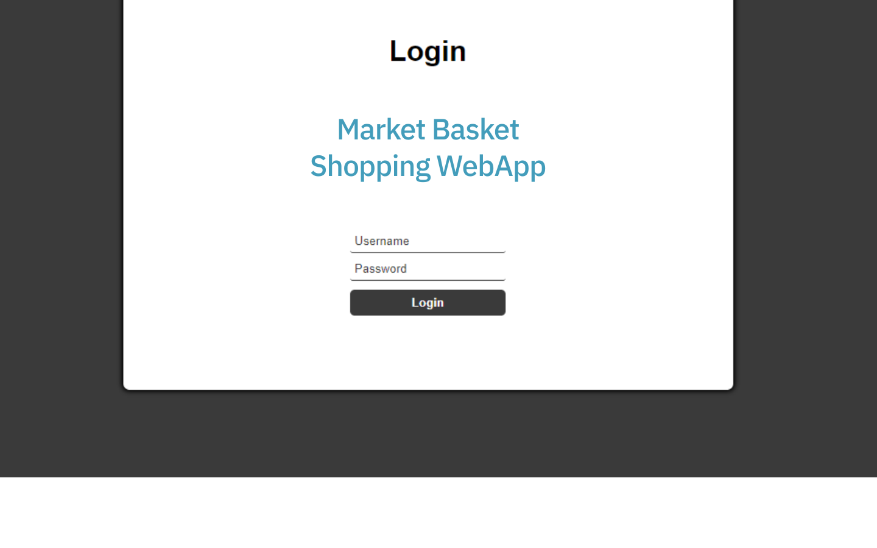
UI Mock-Ups
Notes:
Next three slides show how mock ups of the front end. This a mock up of the login page

Slide 10
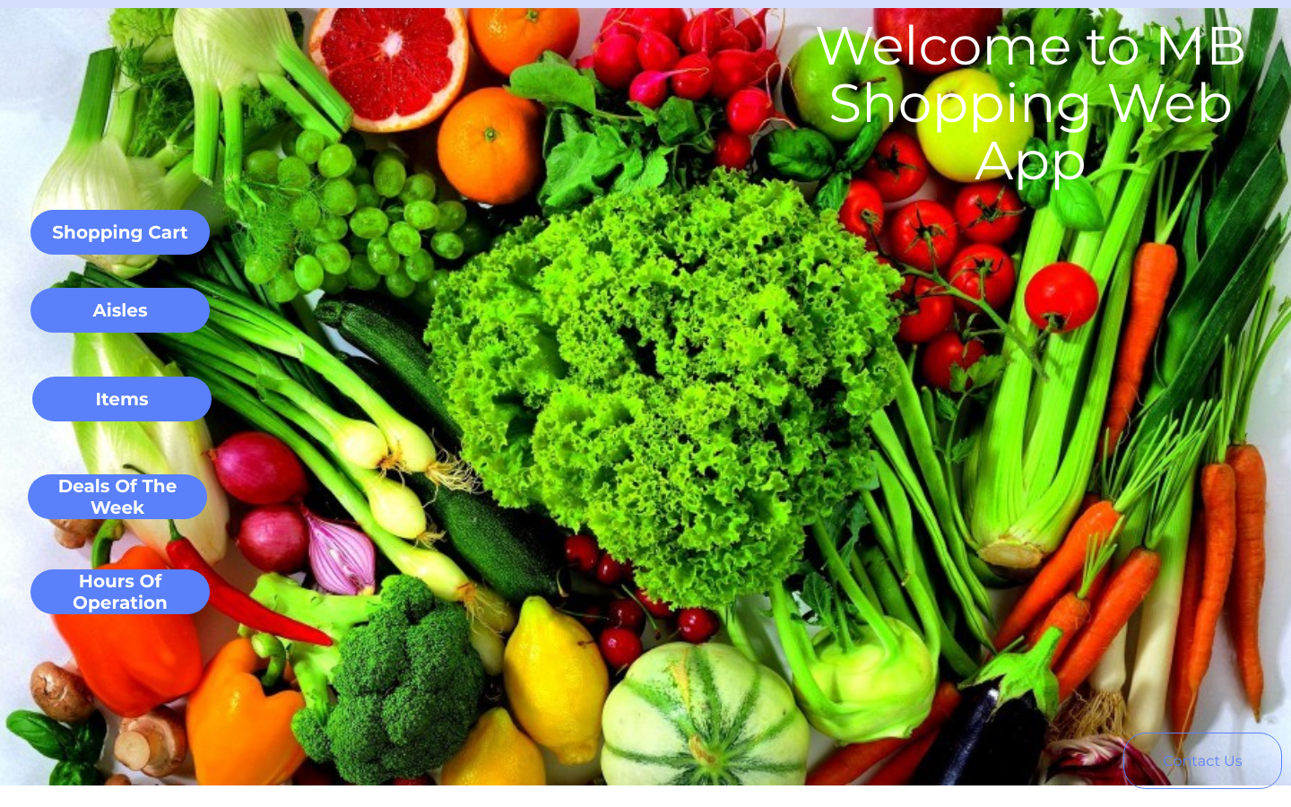
UI Mock-Ups (Shoppers)
Notes:
This one right here is how shoppers would view the Web App after logging in

Slide 11
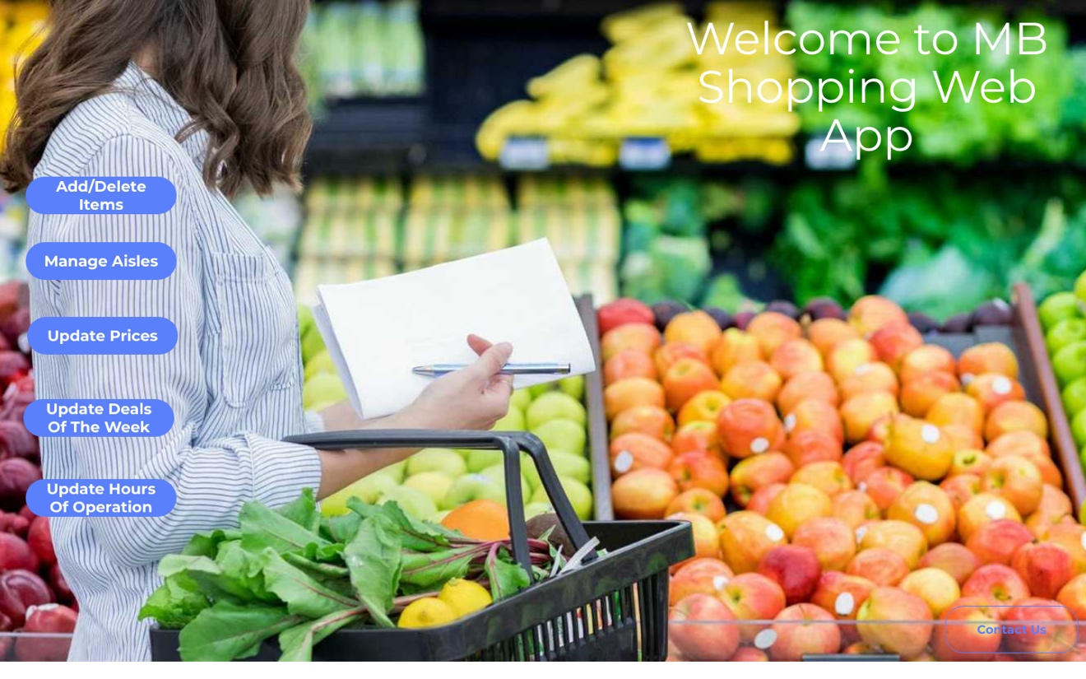
UI Mock-Ups (Admin)
Notes:
This one right here is a mock up that shows how store manager would view the Web App after logging in

Slide 12
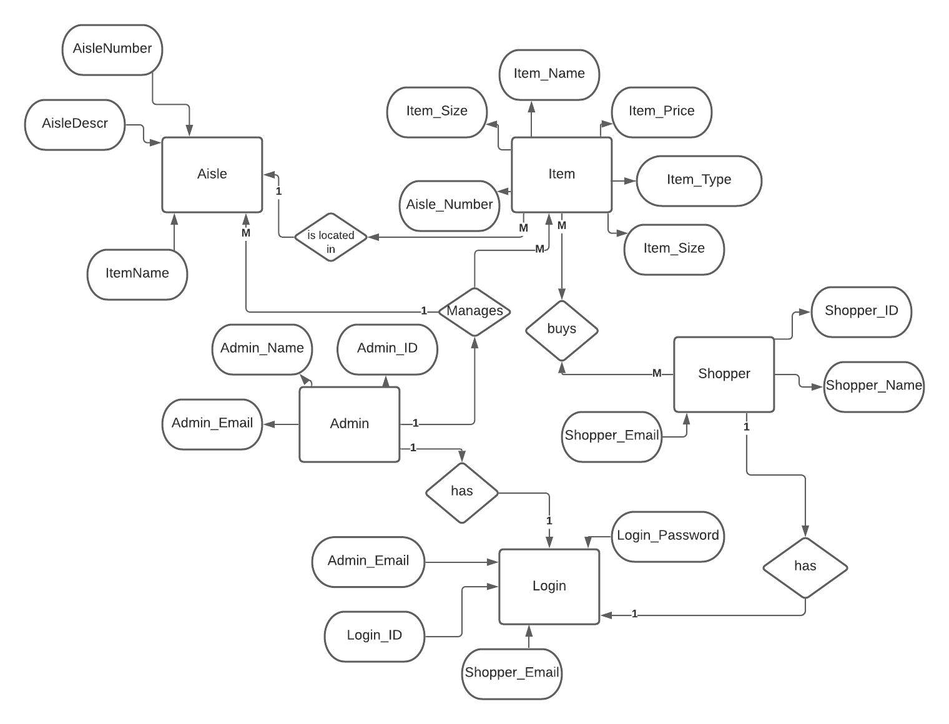
Preliminary Database ER-Diagram
Notes:
Now for the back end. This is the preliminary ER diagram

Slide 13
Benchmark Specification
Benchmark 1: Database design and implementation + testing
Benchmark 2: Implementing shopper’s functionality group 1 + Testing
Benchmark 3: Implementing shopper’s functionality group 2 + Testing
Benchmark 4: Implementing admin’s functionality + Testing
Benchmark 5: Integrated Testing + Report Writing
Notes:
Read each line

Slide 14
Time Schedule
Benchmark 1: 2 weeks
Benchmark 2: 4 weeks
Benchmark 3: 3 weeks
Benchmark 4: 3 weeks
Benchmark 5: 2 weeks
Notes:
Read each line

Slide 15
Grading Scheme for CSC 521
Benchmark 1: 15%
Benchmark 2: 25%
Benchmark 3: 15%
Benchmark 4: 20%
Benchmark 5: 15%
Presentation – 10%
Notes:
Read line

Slide 16
Tool List
Front-End Development Tools:
- HTML
- CSS
- JavaScript
Server-sign Programming Tools:
- PHP
Back-End Database Tools:
- MySQL
- phpMyAdmin
IDEs:
- VS Code
Hardware Tools:
- Linux server
- MySQL server
Other tools:
- FileZilla
Version Control
- Git/GitHub
Notes:
Read each line

Slide 17
Deliverables
Original proposal and presentation files
Amendments to the proposal
Appropriately commented source code
Documentation of project functionality
Sample output
Executables
Presentation documents
Project journal
Project post mortem
Presentation of the completed project
Notes:
Read each line

Slide 18


QUESTIONS ?

